Slide 1
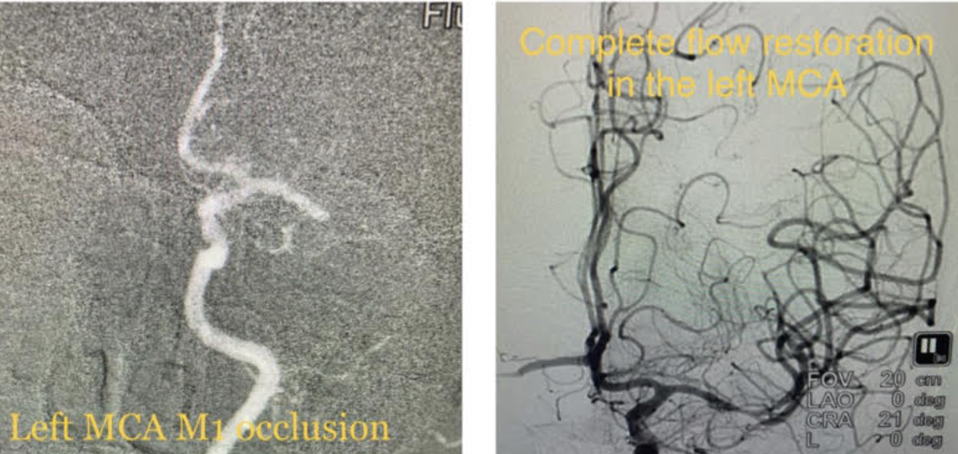
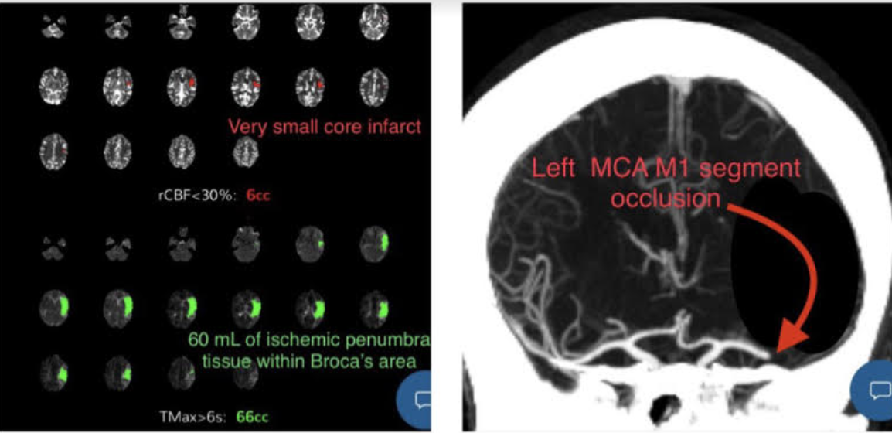
CASE REPORT
Springing into Action for Stroke
Achieving favorable patient outcomes with Viz.ai’s stroke detection and triage technology
GREAT JOB TEAM!
7 MIN
6 MIN
Patient presented with atypical stroke symptoms, challenging IV site access, difficulty determining accurate last known well time and, despite these challenges, the Brandon team using Viz restored flow to her brain and she was discharged home without deficits!
CTA IMAGING – VIZ LVO ALERT
PUNCTURE - REPERFUSION
TIME IS BRAIN
PATIENT PRESENTATION
STROKE IMAGING & ALERT
ENDOVASCULAR INTERVENTION
55F w/ aphasia and emesis while on the phone with her daughter
Baseline mRS 0, NIHSS 6, Aspects 10
TICI 3 Reperfusion
Discharge HOME NIHSS 0
mRS 0. NO DEFICITS!
LAST KNOWN WELL
13:00
ARRIVAL TIME
13:28
CT SCAN
14:50
VIZ LVO ALERT
14:57
GROIN PUNCTURE
16:24
RECANALIZATION
16:30
Stroke Team Champions
MD: Dr. Justin Whisenant | Stroke Coordinator: Ashley Harris, ARNP | ED Team: Dr. Iaun, Dr. Szuzucki , Michael Kendall, RN Neurologist: Dr. Villar
IR Team: Chris Connor IRT, Larita Edwards IRT | Nurses: Lindsay Bly, RN, Sue Keene RN

