Slide 1
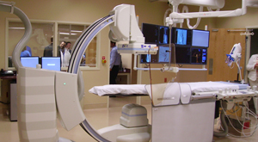
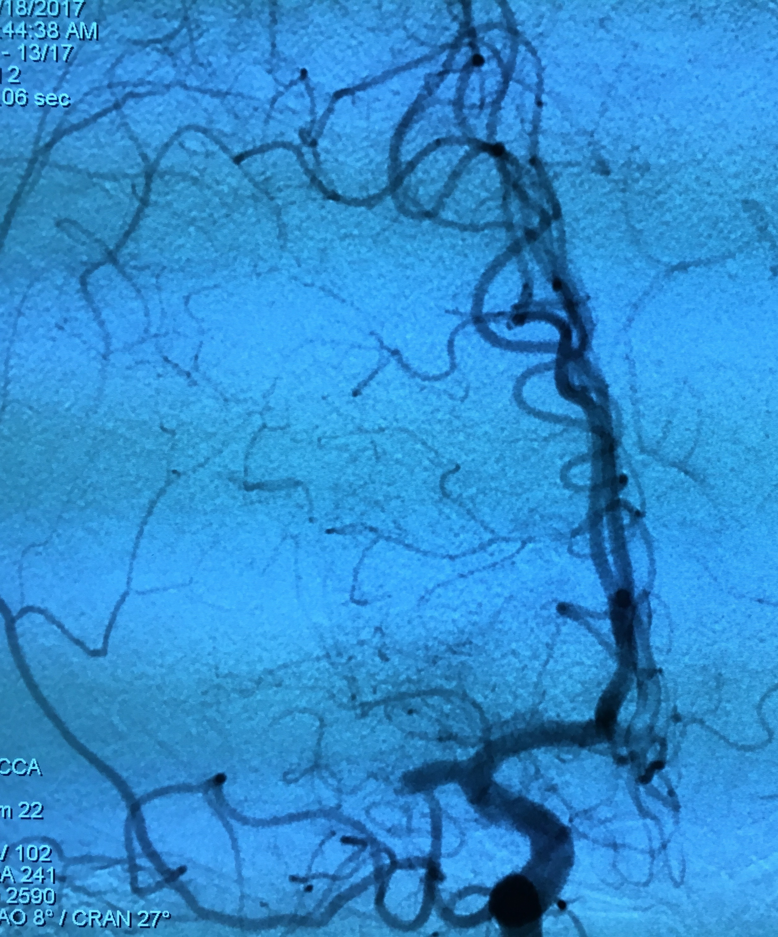
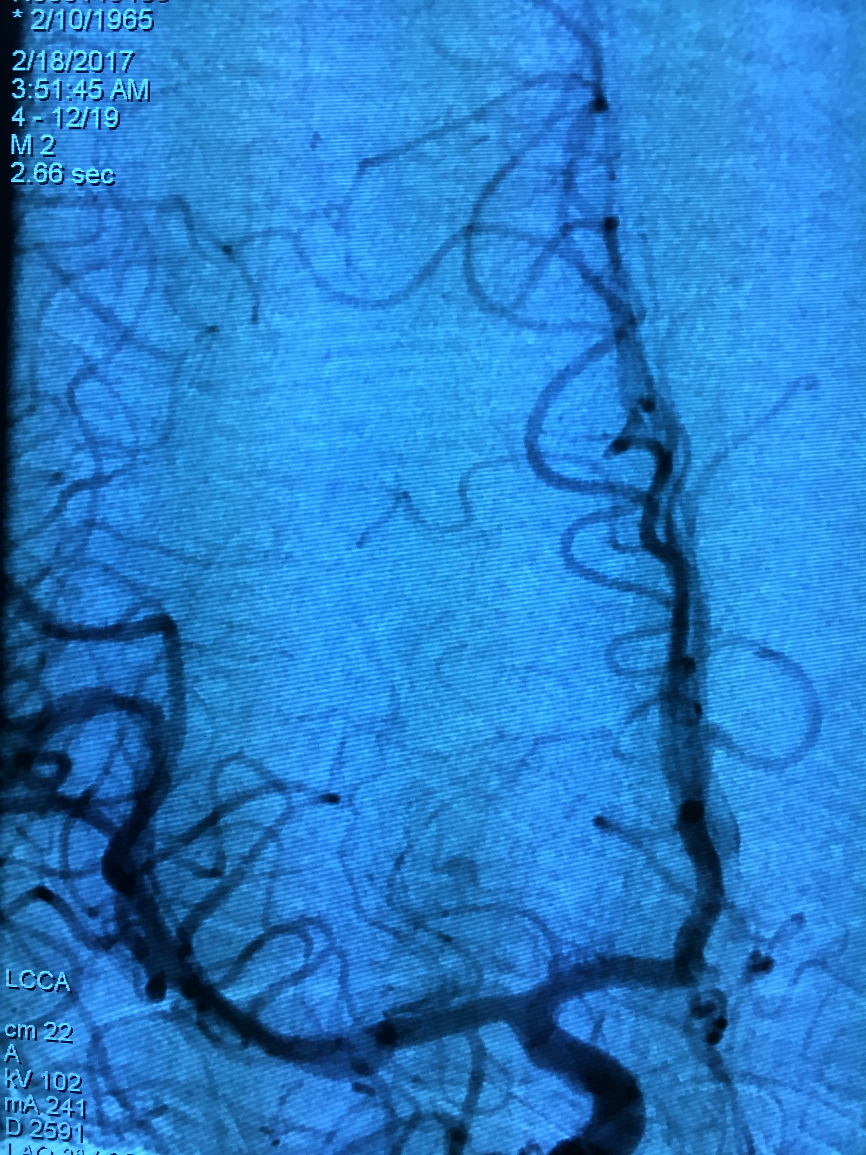
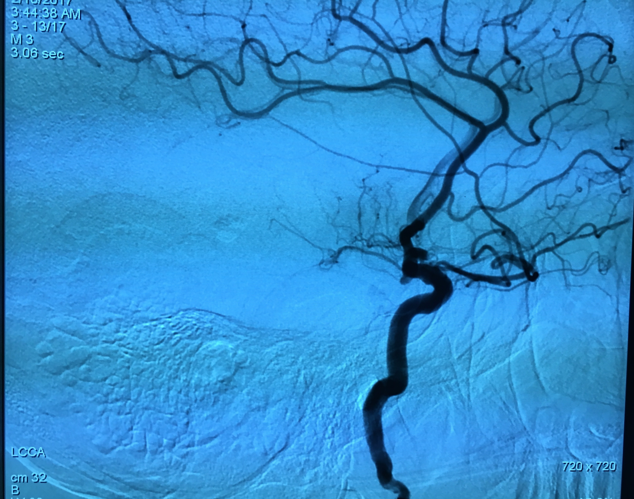
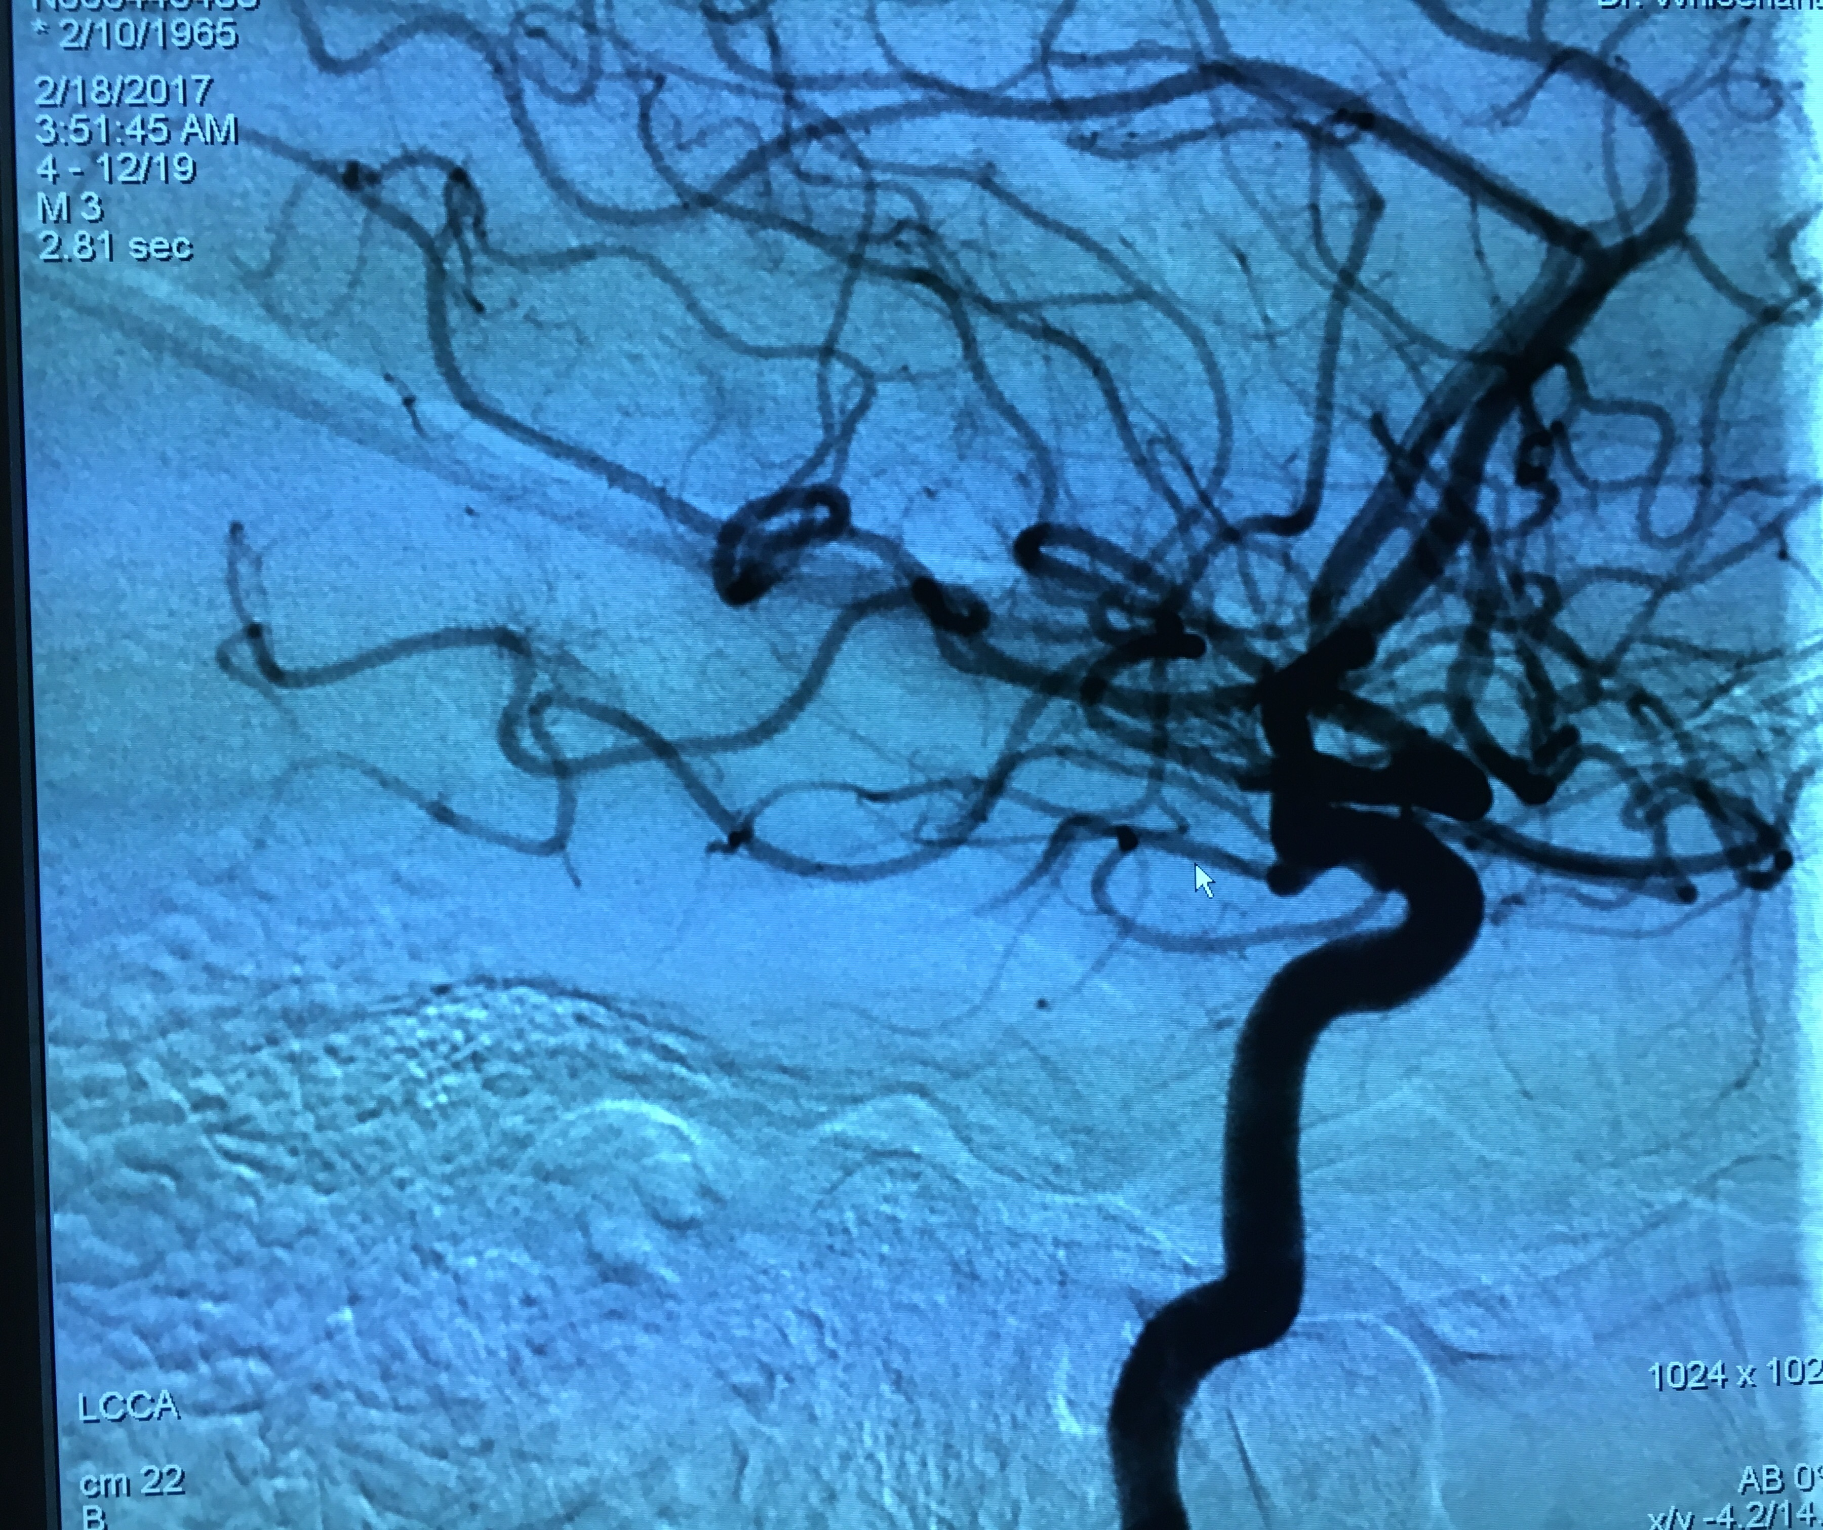
Endovascular Surgical Neuroradiology
Dr. Whisenant arrives to St. Petersburg after 3 years of private practice in Dallas, Texas as an interventional neuroadiologist. Previous to that, he completed two clinical fellowships in neuroradiology and endovascular surgical neuroradiology at the world-renowned Mallinckrodt Institute of Radiology at the Washington University Saint Louis School of Medicine. He received his undergraduate degree from Dartmouth College in Hanover, NH.
Dr. Whisenant most recently completed fellowships in Diagnostic Neuroradiology and Endovascular Surgical Neuroradiology at the Mallinckrodt Institute. He is board certified by the American Board of Radiology.
He is highly skilled in the endovascular treatment of cerebral aneurysms, arteriovenous malformations and fistulas, carotid artery disease, intracranial atherosclerosis, and many other neurovascular conditions of the brain.
Clinical Interests:
Aneurysm
Arteriovenous Malformation
Brain/Spinal Cord Problems
Carotid Artery
Seizures
Stroke
Stroke Prevention
Subarachnoid Hemorrhage
2/18…52 yr old patient given IV tPA and flown from Citrus ED to Northside. CTA/CTP confirmed right MCA occlusion with significant amount of salvageable penumbra. Successful TICI3 revascularization of occluded vessels within 19 minutes of groin puncture.

