Slide 1
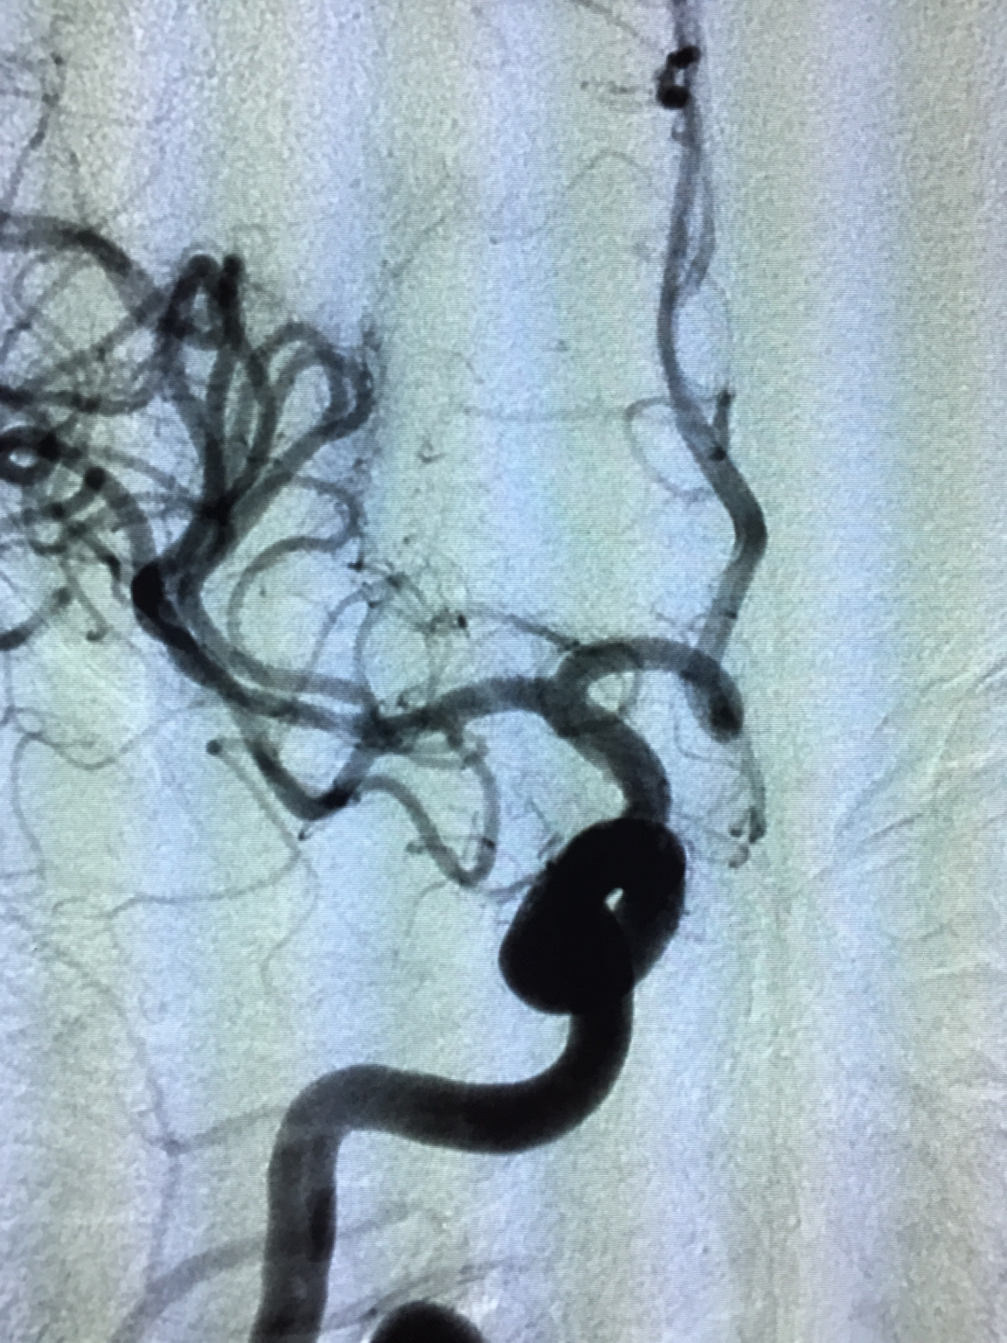
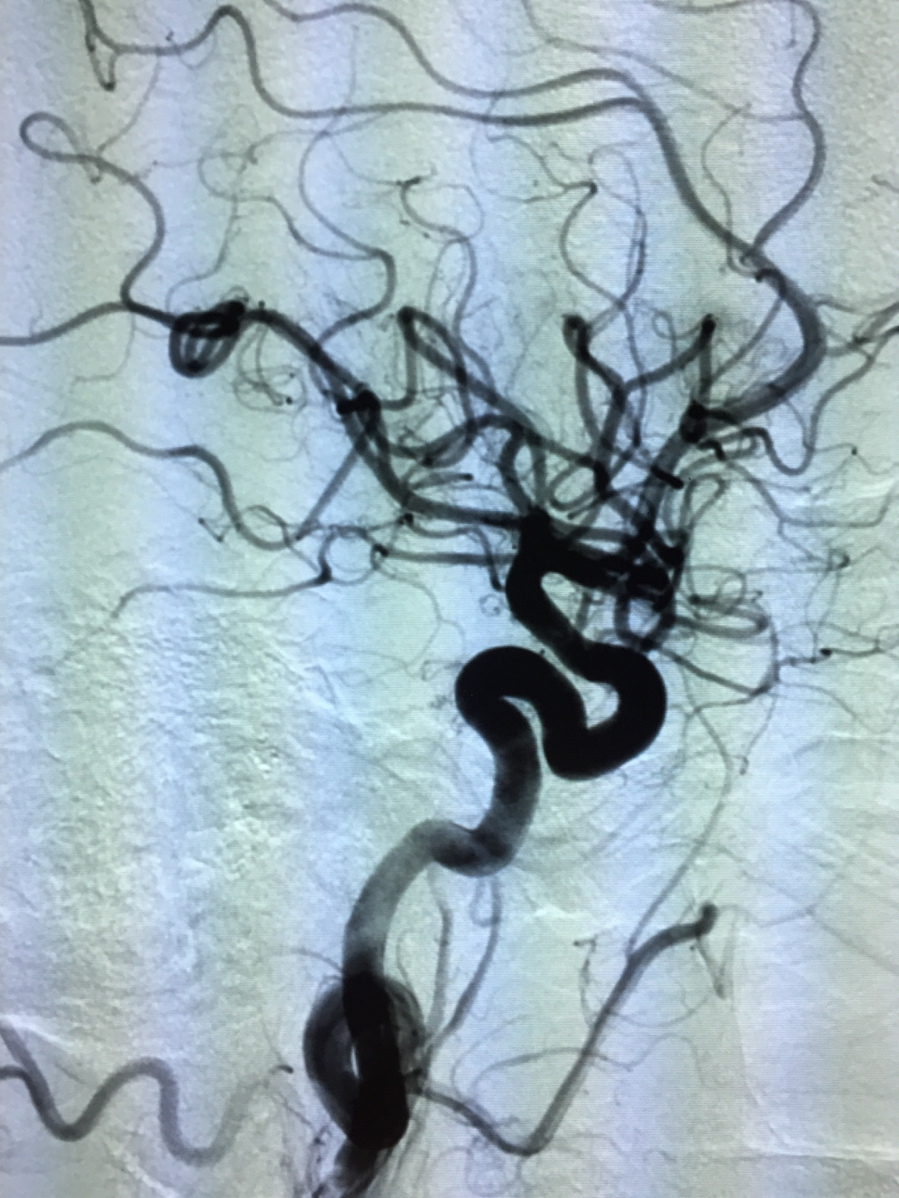
TICI 3 Recanalization Of MCA Artery in a 39 year old
Case Reported by Dr. Justin Whisenant, Northside Hospital
Initial Event: 1/30/2017
39 year old Male
Presented with left sided paralysis, left face, arm, leg weakness, dysarthria
NIHSS of 11
Patient was given IV tPA at 9:34 and was transferred for angiography when no improvement was seen
Last seen normal to TICI 3 recanalization was 4.5 hours
CT Angio demonstrated an occlusion of the right MCA artery. CT Perfusion showed possible penumbra
Angiography confirmed a thrombus in the right MCA
Two pulls of the Trevo XP ProVue Retriever in conjunction with aspiration was used to remove a long, hard clot burden and open the right Middle Cerebral Artery
TICI 3 recanalization was observed
Pre-Treat: AP
Final Angiogram: AP
Pre-Treat: Lateral
Final angiogram: Lateral
NIHSS of 0
Patient discharged home: 2/8/2017
Neuro Interventionalist: Dr. Justin Whisenant
Neurologist: Dr. Jennifer Matos
Teleneurology: Dr. Nima Mowzoon
ED Physician: Dr. Rakhsinda Moeen
Northside Hospital
6000 49th St. North
St. Petersburg, FL 33709
Phone: (727) 521-4411

